Slide 1



MISHAP PREVENTION SYSTEM (MPS)
FINAL REVIEW
SUBMITTED TO : NAGARAJ SV

Slide 2
TEAM MEMBERS
01
02
03
04
Gandla Pravallika – 20BCE1277 (6TH SEM 3RD YEAR)
Katasani Durga Pravalika – 20BCE1427 (6TH SEM 3RD YEAR)
Raparla Puja Sri Pavani – 20BCE1587 (6TH SEM 3RD YEAR)
Kovi Yasaswini – 20BCE1470 (6TH SEM 3RD YEAR)

Slide 3
ABSTRACT
It is now simpler than ever to be involved in an accident because to developing technology and high-end vehicles with more horsepower and usable speed. It is possible for somebody to drive carelessly, endangering the safety of regular people. Road accidents still occur every day, despite the implementation of speed limits and other preventative measures. Overspeeding, reckless driving, and drunk driving are some of the major causes of car accidents.
The proposed work involves creating a technology that prevents motor vehicle accidents brought on by reckless driving, driving drunk, and driving too fast. This gadget will be able to recognise excessive speed and be set up to send an SMS alarm. The device also includes an application which disables the starting of the vehicle engine when alcohol consumption is detected. The device model is designed using Arduino MEGA, Global system for Mobile communication (GSM), Global positioning system (GPS), alcohol sensors.

Slide 4
INTRODUCTION
According to the recent trends, we can observe that there is a rapid increase in the death rate due to the negligence of the driving person. So the main aim of our project is to built an application that reduces the death rate there by contributing to make a change in the mindset of the people in such a way that they take minimum precautions while driving this helps to reduce the death rate of the innocent people who follow the rules but are effected by the people who drive with negligence. In our project we mainly focus on three activities of the driver namely alcoholic, tired and over speed. When any one of the three activities is done by the user we warn them using alarms but still they don't follow we will block the engine and impose the fine for that particular activity and if this continuously repeats for certain number of times severe actions will be taken. To implementation part is given in detail in the following slides.

Slide 5
AREAS FOCUSED ON
When a person is driving the vehicle fast
Overspeed
01
02
03
Drunk and Drive
Sleepy
When a person drinks and drives the vehicle
When a person gets sleepy when he is driving the vehicle

Slide 6
OBJECTIVES
The main objectives of the project are:
Alcohol detection
Speed supervising
Driver safety
Decrease fatality due to accidents
To provide information about the condition of the driver to respective authorities

Slide 7
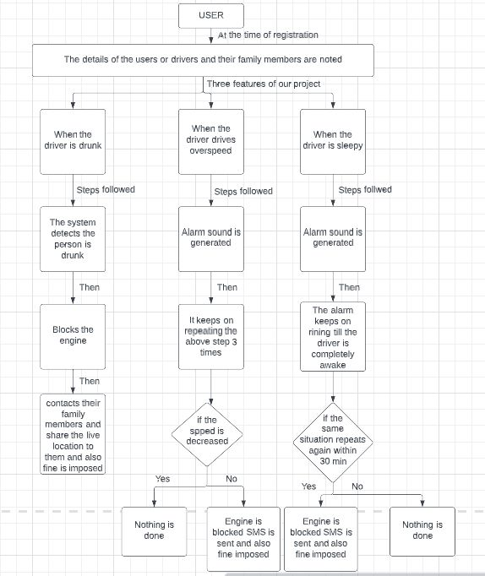
WORK FLOW

Slide 8
COMPONENTS
HARDWARE
SOFTWARE
ALCOHOL SENSOR
GPS MODULE
GSM MODULE
LCD DISPLAY
RELAY
ARDUINO
As Arduino is the heart of the project we have use Arduino IDE. It is an open source software and is accessible to anyone.

Slide 9
WHAT’S NEW?
As we know that there are many applications to reduce the accidents in the market. So definitely there raises a question why should one choose our project over the others. Here's the answer for that:
Yeah ,its true that there are many applications to reduce the mishaps but the unique feature in our project is that we unite the three activities and aggregate it as a same project and which is not done before and we even implement this in all kinds of vehicles and our project is not only confined to particular activity. We would definitely say that our project has the capability to change the mindset of the people in such a way that they do contribute to prevent the mishaps.

Slide 10
COMPONENTS DESCRIPTION

Slide 11
ALCOHOL SENSOR
COMPONENT: ALCOHOL SENSOR
MAIN FUNCTIONALITY: The MQ-3 alcohol sensor is a type of gas sensor that is designed to detect the presence of alcohol vapor in the air. Its main functionality is to provide a quantitative measure of the concentration of alcohol in the surrounding environment.
NEED OF THE COMPONENT IN THE PROJECT: As we have discussed, one of the three areas on which our project is more inclined is consumption of alcohol. So, to detect if the driver has consumed alcohol, we have decided to make use of MQ-3 sensor.
APPLICATIONS OF IT IN REAL WORLD: Smart homes. Breathalyzer devices, Industrial safety

Slide 12
GPS MODULE
COMPONENT: GPS MODULE
MAIN FUNCTIONALITY: A GPS (Global Positioning System) module is a device that uses satellite signals to determine the precise location of an object, person or vehicle. The main functionality of a GPS module is to provide accurate and real-time positioning information.
NEED OF THE COMPONENT IN THE PROJECT: As we have stated that, we will be sending an SMS to the registered mobile number along with the current location. To detect the current location, we have decided to use the GPS module.
APPLICATIONS OF IT IN REAL WORLD: Navigation, Tracking, Geofencing

Slide 13
GSM MODULE
COMPONENT: GSM MODULE
MAIN FUNCTIONALITY: A customized Global System for Mobile communication (GSM) module is designed for wireless radiation monitoring through Short Messaging Service (SMS). This module is able to receive serial data from radiation monitoring devices such as survey meter or area monitor and transmit the data as text SMS to a host server.
NEED OF THE COMPONENT IN THE PROJECT: As we have stated that, we will be sending an SMS to the registered mobile number along with the current location. After detecting the current location, to send the SMS we have decided to use GSM module .
APPLICATIONS OF IT IN REAL WORLD: Security systems, Internet of Things (IoT), Mobile communication

Slide 14
LCD DISPLAY
COMPONENT: LCD DISPLAY
MAIN FUNCTIONALITY: The main functionality of an LCD (Liquid Crystal Display) is to provide a visual display of information. An LCD is a flat-panel display that uses liquid crystals to produce images.
NEED OF THE COMPONENT IN THE PROJECT: As we have discussed when the person is drunken, sleepy or driving with overspeed the alerts will be given to the person according to the action performed. To make the driver understand the reason behind the alert, we have decided to use LCD display to display the message to the driver.
APPLICATIONS OF IT IN REAL WORLD: Automotive, Medical Devices, Consumer Electronics

Slide 15
RELAY
COMPONENT: Relay
MAIN FUNCTIONALITY: The main functionality of a relay is to control the flow of electrical current. A relay is an electromagnetic switch that uses a small current to control a larger current. It consists of an electromagnet, an armature, and a set of contacts.
NEED OF THE COMPONENT IN THE PROJECT: As we have mentioned that engine will be locked once the system detects any one of the three main causes of the accident. As, A relay can be used in a safety circuit to ensure that certain equipment or processes are shut down in case of an emergency we have decided to use this relay to stop the engine or motor.
APPLICATIONS OF IT IN REAL WORLD: Power Electronics, Automotive, Home and Industrial Automation

Slide 16
AURDINO UNO
COMPONENT: AURDINO UNO
MAIN FUNCTIONALITY: The Arduino Uno is a microcontroller board that is designed to make it easy to create electronic projects. The main functionality of the Arduino Uno board is to provide a platform for programming and controlling various electronic components using software.
NEED OF THE COMPONENT IN THE PROJECT: To make all the functionalities of the project work we have to code it and then implement it.For making this happen we have decided to use Audino uno as a platform for programming and controlling ask the components using software.
APPLICATIONS OF IT IN REAL WORLD: Robotics, Home automation, Environmental Monitoring

Slide 17
EYE BLINK SENSOR
COMPONENT: Eye blink sensor
MAIN FUNCTIONALITY: The main functionality of an eye blink sensor is to detect the blinking of an eye and provide an output signal that can be used for various applications. The sensor typically uses infrared light to detect the movement of the eye and measures the changes in light intensity to determine when the eye is blinking.
NEED OF THE COMPONENT IN THE PROJECT: As we have discussed, one of the three areas on which our project is more inclined is the sleepy feeling of the driver. So, to detect if the driver is sleepy, we have decided to make use of eye blink sensor.
APPLICATIONS OF IT IN REAL WORLD: Virtual Reality, Medical Diagnostics, Human-Computer Interaction

Slide 18
TEMPERATURE SENSOR
COMPONENT: TEMPERATURE SENSOR
MAIN FUNCTIONALITY: The main functionality of a temperature sensor is to measure the temperature of a specific object or environment and provide an output signal that corresponds to that temperature.
NEED OF THE COMPONENT IN THE PROJECT: As we have discussed, one of the three areas on which our project is more inclined is the overspeed of the driver. So, to detect if the driver is driving with high speed, we have decided to make use of temperature sensor. It detects if the engine is over heated due to the over speed.
APPLICATIONS OF IT IN REAL WORLD: Medical devices, Food industry, Aerospace industry

Slide 19
RESISTOR
COMPONENT: Resistor
MAIN FUNCTIONALITY: The main functionality of a resistor is to limit the amount of current that flows through a circuit. This is important because in many electronic circuits, the components are designed to operate within a specific range of currents. If the current is too high, it can damage the components or cause the circuit to malfunction.
NEED OF THE COMPONENT IN THE PROJECT: the use of a resistor in a mishap prevention system is to ensure accurate and reliable sensing, while protecting the system components from damage.
APPLICATIONS OF IT IN REAL WORLD: Electronics,Lighting,Power distribution.

Slide 20
DC MOTOR
COMPONENT: Dc motor
MAIN FUNCTIONALITY: A DC motor consists of a rotor, which is a rotating part, and a stator, which is the stationary part of the motor. The main functionality of a DC motor is to convert electrical energy into mechanical energy. It achieves this by utilizing the interaction between magnetic fields to generate rotational motion.
NEED OF THE COMPONENT IN THE PROJECT: To demonstrate the project dc motor can be used as engine.
APPLICATIONS OF IT IN REAL WORLD: Automotive, Robotics, Industrial machinery of the section here

Slide 21
BUZZER
COMPONENT: Buzzer
MAIN FUNCTIONALITY: A buzzer or beeper is an audio signaling device, which may be mechanical, electromechanical, or piezoelectric.
NEED OF THE COMPONENT IN THE PROJECT: To alert the user buzzer is used.
APPLICATIONS OF IT IN REAL WORLD: Alaram devices, timers

Slide 22
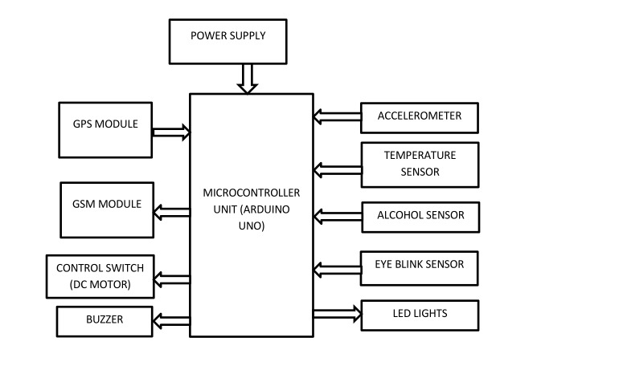
BLOCK DIAGRAM
Despite being red, Mars is actually a cold place. It’s full of iron oxide dust

Slide 23
IMPLEMENTATION

Slide 24
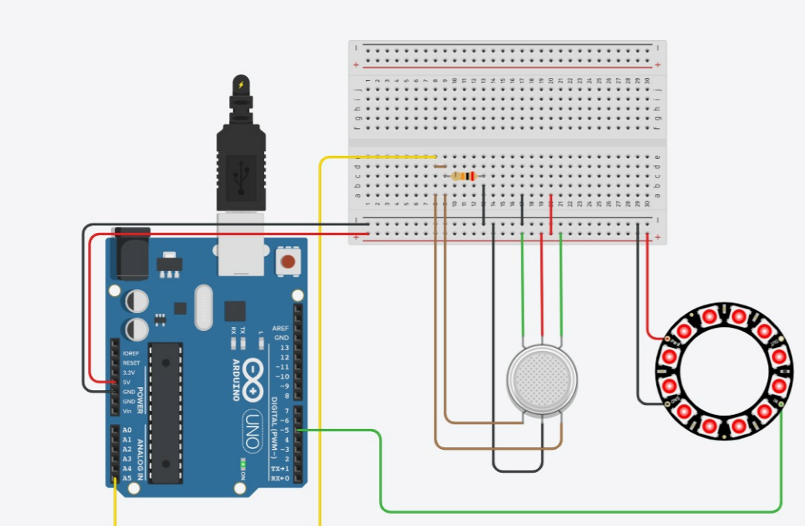
STEP – 01: USING ALCOHOL SENSOR

Slide 25
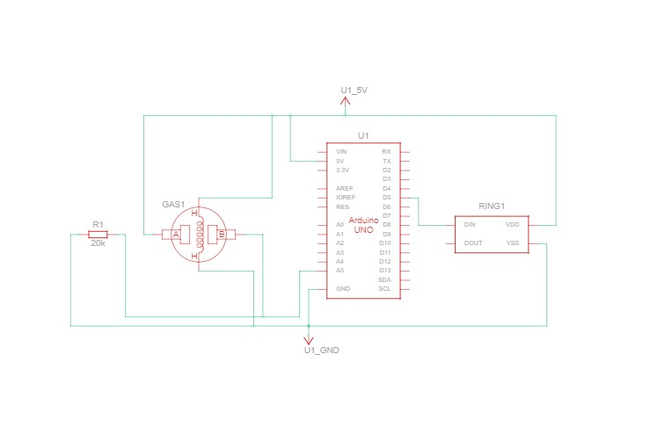
SCHEMATIC DIAGRAM
https://www.tinkercad.com/things/3jfEF79kezk-copy-of-alcohol-detection/editel?tenant=circuits

Slide 26
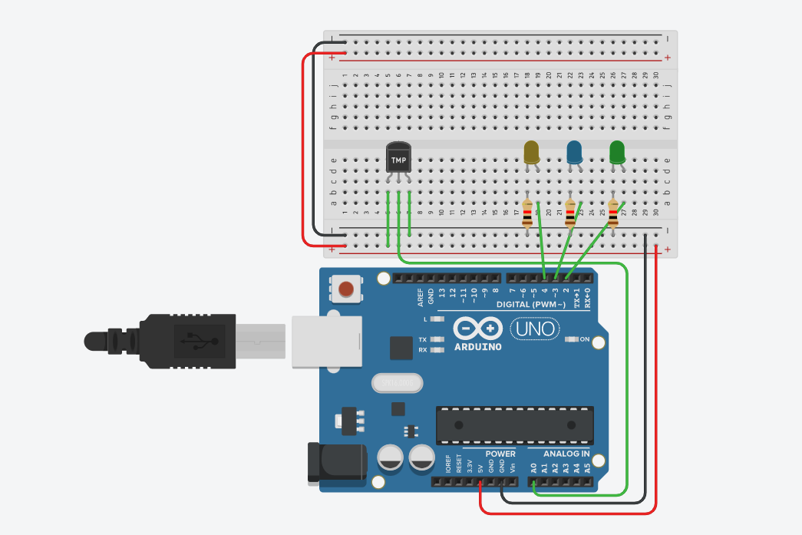
STEP 02: USING TEMPERATURE SENSOR

Slide 27
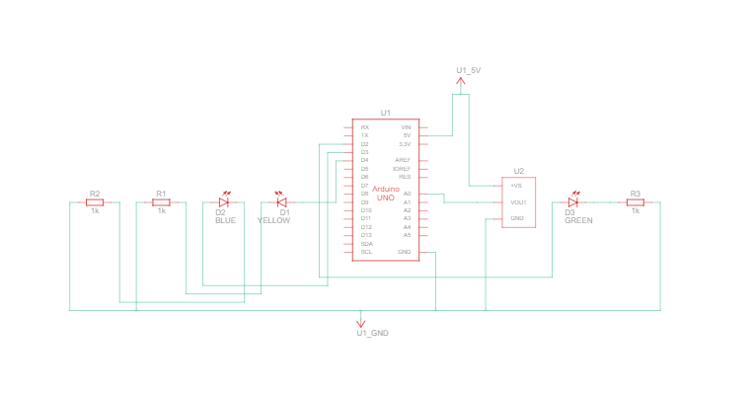
SCHEMATIC DIAGRAM
https://www.tinkercad.com/things/3OLk9mpOLD3-copy-of-tmp36-temperature-sensor-with-arduino/editel?tenant=circuits

Slide 28
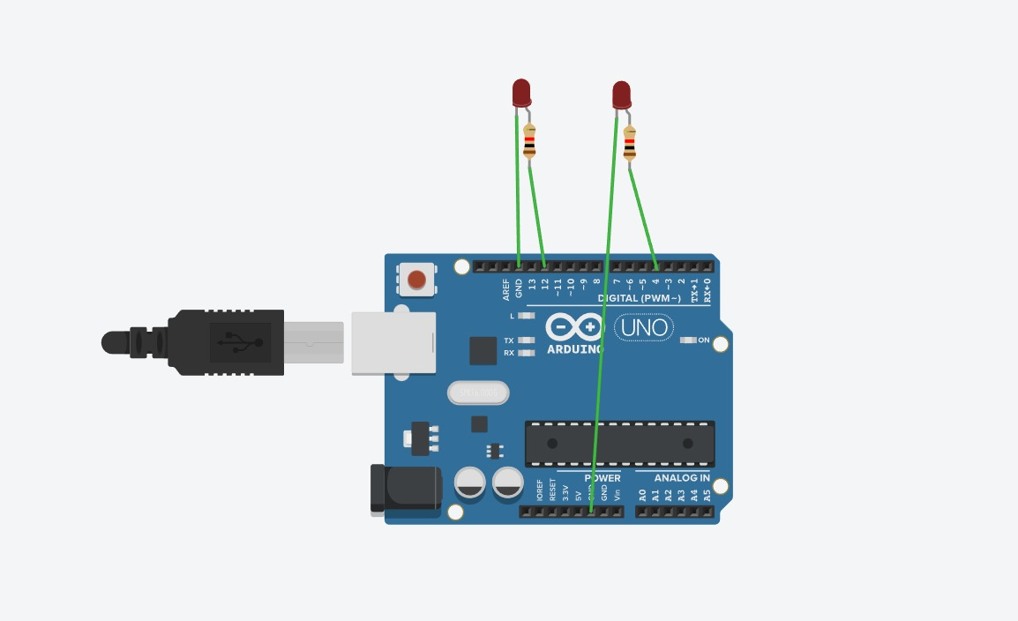
STEP 03: USING EYEBLINK SENSOR

Slide 29
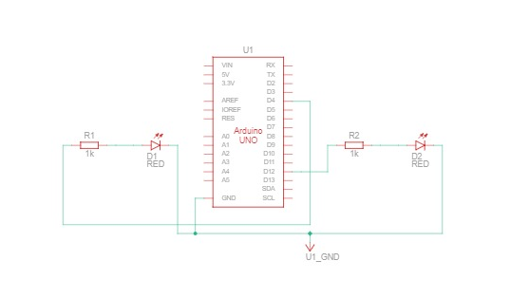
SCHEMATIC DIAGRAM
https://www.tinkercad.com/things/kmOag6mjZ4V-copy-of-arduino-eye-blink-robot/editel?tenant=circuits

Slide 30
IMPLEMENTATION USING PROTEUS

Slide 31
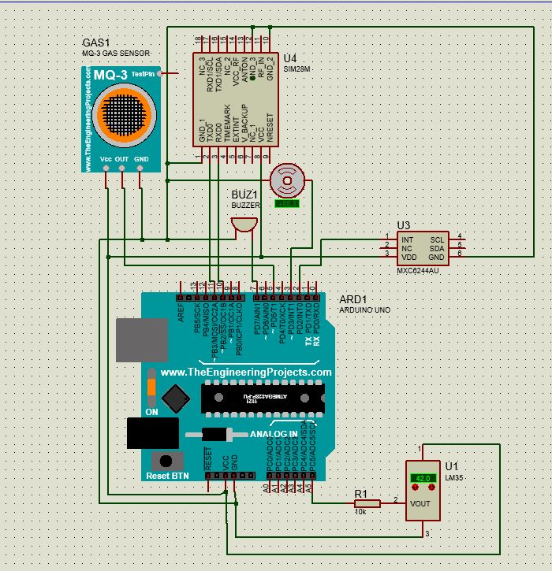

Slide 32
OVERVIEW OF IMPLEMENTATION
Initially we have decided to look into the working of each objective of our project in detail .Based on this we initially made an hardware set up to check out first objective that is accidents due to alcohol consumption , for this we have taken mq-3 sensor and we have done the necessary hardware set up and checked the working and then we had moved on to the second objective that is accidents due to overspeed and for this we have used temperature sensor and an led and made the necessary hardware set up and checked with the results and then finally we have come to the third objective that is accidents due to drowsiness and for this we have used eye blink sensor and made the necessary hardware set up and checked with the results. To know the overall working of the project we have combined all the three objectives with the help of proteus software and for this we have also added the GPS and GSM sensors and the output was exactly what we have expected.

Slide 33
CODE USED FOR IMPLEMENTATION
https://drive.google.com/file/d/1ThgquMSAW03XlaL8-QIz_6xAFn_ucICq/view?usp=share_link

Slide 34
FIELD VISIT THROUGH GOOGLE FORM
FORM LINK : https://forms.office.com/r/Yyt9hU6JMF

Slide 35
INTERPRETATION OF RESULTS

Slide 36
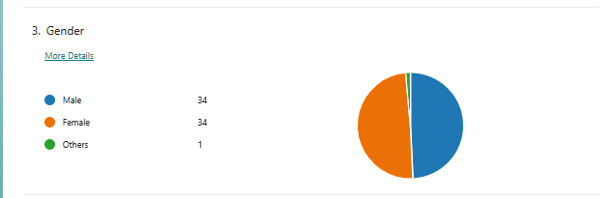
As we can observe, nowadays society is more inclined towards gender equality so to analyze our results ,we have shared our form to equal number of males and females to know their view on our project . By doing this we can come to know about the correct analysis of our project in the perspective of current generation.

Slide 37
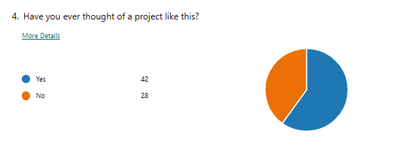
As you can see from the above pie chart we an say that majority of the people had a thought on this project so implementing this project will be very helpful to the society.

Slide 38
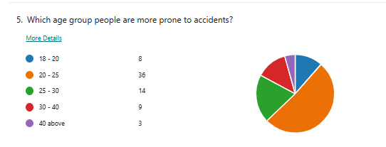
As you can see from the above piechart we can say that most of the people of age group between 20-25 are prone to accidents because the people of this age group are youngsters due to lack of safety measures and lack of knowledge on government policies most of them in this age group are prone to accidents.

Slide 39
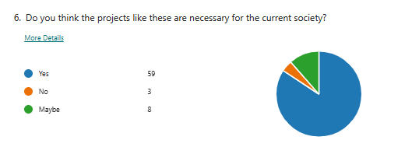
From the responses that we got almost all the respondents felt that project like the mishap prevention system is almost necessary for the current society, which is really a boosting force to work on this area in an wider range

Slide 40
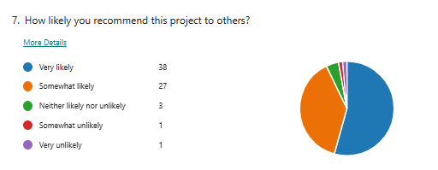
Almost 85 percent of the respondents are more likely to recommend the project of mishap prevention system to others as they might have thought that this project is really helpful in preventing the accidents . This can be viewed as the driving force for our project.

Slide 41
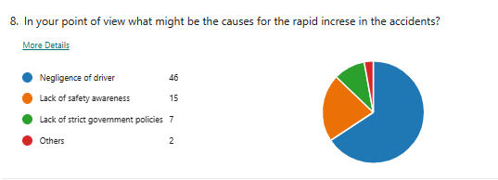
More than 50 percent of the respondents feel that negligence while driving is the main cause for the accidents . The results that we got for this question highly supports the objective of our project.

Slide 42
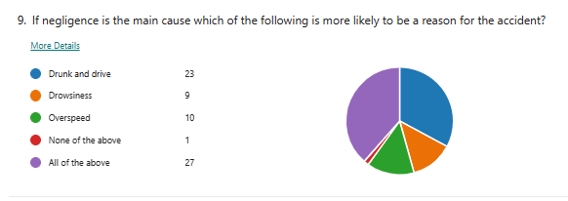
For this question we got a mixed response that around 40 percent of the respondents feel drunk and drive is the main cause for the accident whereas other 40 percent of the respondents feel drunk and drive, drowsiness and overspeed are the causes of the accident . In either of the way our project is very helpful in avoiding accidents caused by the mentioned factors.

Slide 43
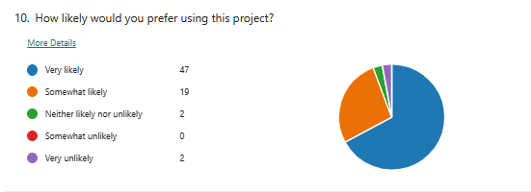
More than 75 percent of the respondents are willing to prefer our project in order to avoid accidents, which can be treated as the positive response and builds up the spirit for the investors.

Slide 44
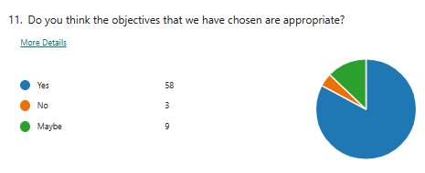
Almost 90 percent of the respondents agree that the three main objectives that we have chosen for our project are appropriate and from this response we can conclude that we are thinking in the way which exactly meets the requirements of the society.

Slide 45
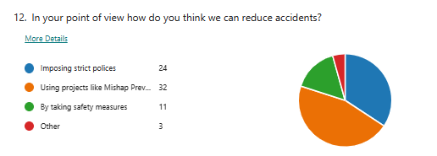
Almost 40 percent of the people feel that the projects like mishap prevention system can be used to prevent the accidents whereas other 30 percent of the respondents feel imposing strict polices helps to reduce the accidents . From this we can conclude there are people who really thinks that projects like these are really helpful.

Slide 46
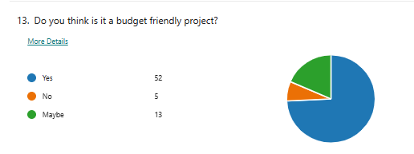
As we can see that most of the people are thinking this project as budget friendly and thought that this project that worth the cost and willing to buy it which will be helpful to the society.

Slide 47
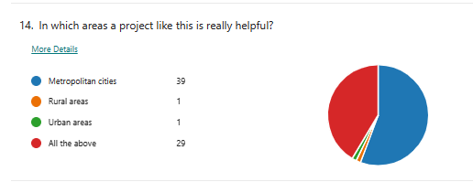
From the above chart we can say that most of the people felt that this project will be helpful in the metropolitan cities because those are the cities where almost most of the people will be using vehicles and those are the places with heavy traffic and are prone to accidents.

Slide 48
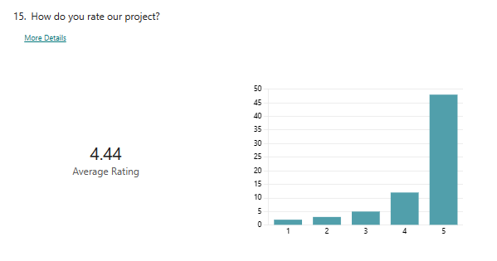
From the above result we can say that according to the survey that we have done majority of the people liked the idea of the project and thought it is useful to the society and most of the people gave high rating by which implementing this project has a high chance of success rate and useful to the society.

Slide 49
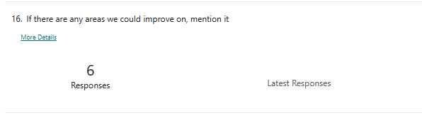
As a part of this question most of the respondents didn't suggest any suggestions or enhancements .And few of them have suggested to use the existing monitoring system provided by telsa manufacturers and this is actually helpful and we will be trying to implement it in the future.

Slide 50
OVERALL ANALYSIS OF GOOGLE FORM
As the part of field visit we have circulated a Google form to all the members who can actually provide us an review on our project.The google form consist of nearly 16 questions through which we can know the performance and need of our project.The results of the google form were really surprising as they were beyond our imagination.Almost all the responses were in favour of our project and the respondents are in a view that the project is really helpful for the Society in preventing the accidents which is really an boosting force for us to work on it even more effectively and the respondents felt that the project that we have developed is focusing on the correct objectives which made us built the confidence that we are on the right side.Overall the results of the survey are too supportive to our project and we feel that if a project like mishap prevention system is introduced all the members would really show interest in using it and thereby preventing accidents.

Slide 51
Budget
After discussing and exploring about the components required for the project we came to a conclusion that it costs around nearly 4000 INR to finish the project.

Slide 52
FUTURE WORK
Improving the design of the locking system: The locking system itself could be improved to make it more robust and reliable. This could involve using higher quality materials, redesigning certain components, or incorporating redundant safety features. Developing better monitoring and alert systems: The engine locking system could be augmented with better monitoring and alert systems. For example, sensors could be placed on various components of the locking system to detect when something is not functioning properly. An alarm or warning light could then be triggered to alert the driver.
Implementing advanced control systems: Advanced control systems could be implemented to manage the engine locking system. This could involve using artificial intelligence or machine learning algorithms to detect patterns in the system's behaviour and identify potential issues before they become serious problems. Conducting more rigorous testing and evaluation: More extensive testing and evaluation of the locking system could be conducted to identify potential failure modes and weaknesses. This could involve testing the system under different environmental conditions, such as extreme temperatures or vibrations.
Providing better training for drivers: Drivers could be provided with more comprehensive training on how the locking system works and what to do in the event of a malfunction. This could include simulated scenarios where the locking system fails and drivers must respond quickly and appropriately. Developing a backup locking system: A backup locking system could be developed to provide an additional layer of safety in the event that the primary locking system fails. This could involve using a different type of locking mechanism or incorporating redundant components into the system.

Slide 53
CONCLUSION
In conclusion, the engine locking system is a crucial safety feature that can prevent accidents and save lives. The project aims to develop an engine locking system that can automatically shut off the engine when certain conditions are met, such as when the driver is not in the vehicle or when the vehicle is in a dangerous situation. The implementation of this system can significantly reduce the number of accidents caused by runaway vehicles and can also prevent theft. The project requires a thorough analysis of the system's design and implementation, including the selection of appropriate sensors and actuators, as well as the development of reliable software algorithms.
Overall, the engine locking system is a valuable addition to vehicle safety, and the successful implementation of this project can make a significant impact in reducing accidents and saving lives. As we have mentioned, the main aim of our project is to reduce the mishaps and ensure safe riding. We wish that the accidents will be reduced and all the citizens will develop the minimum precautions and ensure that they follow all the rules and do not create any trouble to others.
The goal of our project is to make the people understand that these rules are meant for their welfare. We hope that the death rate of the people caused due to the road accidents decreases at least to some extent by implementing our project.

Slide 54
THANK YOU

